Slide 1
UFCFB6-30-2 Object-oriented Software Development
Unit 11 Basic Concurrency and Java Threads
Benedict R. Gaster
2016-17

Slide 2
Outline
Defining and creating threads
Thread methods
Examples with multiple threads
An example with user interface

Slide 3
Why multithreading?
Most of the java programs you have seen so far can only do one thing at a time. In the real world many actions are happening concurrently.
Typical applications:
User interfacing, e.g. One deals with the drawing, the other deals with user interface
Many instances of similar behaviour, e.g. a concurrent server serves many clients
Many different tasks

Slide 4
Draw threads
main
mythread

Slide 5
Two ways to define threads in Java
Extending the Thread class
Implementing the Runnable interface

Slide 6
Key elements for extending Thread 1
class NewThread extends Thread {
…
//override the run method
public void run() {
//define how the thread runs
…
}
…
}
http://docs.oracle.com/javase/7/docs/api/java/lang/Thread.html

Slide 7
Key element for extending Thread 2
class MyApplication {
…
public static void main(String [] args){
NewThread mythread=new NewThread();
…
mythread.start();
}
}

Slide 8
Main thread, t1 and t2
main
t1
t2

Slide 9
An example: A thread printing its id repeatedly
class MyThread extends Thread {
private String threadID;
MyThread(String s) { threadID=s; }
public void run() {
for (int i=0;i<2000;i++){
System.out.println(“Thread ” + threadID);
}//for
}//run
} //MyThread

Slide 10
An example: two threads printing their ids
public class SeveralThreads {
public static void main(String [] args) { MyThread t1,t2; //create threads t1 = new MyThread("t1"); t2 = new MyThread("t2"); //start threads
t1.start(); t2.start();
//… other statements }//main
}//SeveralThreads
What happens if we have t1.run() instead of t1.start()?

Slide 11
Main thread, t1 and t2
main
t1
t2

Slide 12
An example: two threads printing their ids
What happens if we have t1.run(); t2.run();
instead of
t1.start(); t2.start();
All the Thread t1, followed by all the Thread t2
Thread t1
Thread t2
Thread t2
Thread t1
Thread t1
Thread t2
Thread t1
Thread t2
Thread t1
Thread t2
…
Notes:
Run the Severalthread program in E:\Teaching\Client_server\Run2006-7\Code\ClientServer. Package threads

Slide 13
Creating threads by extending the Thread class
Define a class, e.g. NewThread, extending the Thread class
Override the run() method to tell the system how the thread will be executed when it runs.
Create an instance of NewThread,
Invoke the start() method to tell the system to start the thread and to execute the run() method.

Slide 14
Interface revision: the next two slides

Slide 15
An Interface example
public interface EmploybilitySkills{
void hasProgammingExp();
void hasCommunicationSkills();
}

Slide 16
Implementing interface
public class CSStudent extends Student implements Employability{
private String supervisor;
CSStudent (String nm){
super(nm);}
… … //other methods
public void hasProgrammingExp(){
System.out.println("Lots of Java");
}
public void hasCommunicationSkills(){
System.out.println(“assessment via presentations");
}
}
public class ITMBStudent extends Student implements Employability{
…
public void hasProgrammingExp(){
System.out.println(“Some PhP and Python");
}
public void hasCommunicationSkills(){
System.out.println(“group projects with real clients");
}
}

Slide 17
Creating threads by implementing the Runnable interface
Define a class, e.g. NewTask, implementing the Runnable interface
implement the run() method to tell the system how the task will be executed when it runs.
Create an instance of NewTask, e.g. t1
The task needs to be executed in a thread. Create an instance of Thread with t1 as the parameter
Invoke the start() method of the thread to tell the system to start the thread.

Slide 18
Key elements for implementing Runnable 1
class NewTask implements Runnable {
…
//implement the run method
public void run() {
//define how the thread runs
…
}
…
}

Slide 19
Key elements for implementing Runnable 2
class MyApplication {
…
public static void main(String [] args){
NewTask mytask=new NewTask();
Thread mythread=new Thread(mytask);
…
mythread.start();
}
…
}

Slide 20
Creating threads by implementing the Runnable interface
Define a class, e.g. NewTask, implementing the Runnable interface
implement the run() method to tell the system how the task will be executed when it runs.
Create an instance of NewTask, e.g. t1
The task needs to be executed in a thread. Create an instance of Thread with t1 as the parameter
Invoke the start() method of the thread to tell the system to start the thread.

Slide 21
An example: thread printing its id using implementing Runnable
class MyTask implements Runnable {
private String threadID;
MyTask(String s) { threadID=s; }
public void run() {
for (int i=0;i<2000;i++){
System.out.println(“Thread ”+ threadID);
}//for
}//run
} //MyTask

Slide 22
An example: two threads printing their ids using implementing Runnable
public class SeveralThreads {
public static void main(String[] args) { MyTask t1 = new MyTask("t1"); MyTask t2 = new MyTask("t2");
Thread tt1=new Thread(t1);
Thread tt2=new Thread(t2);
tt1.start(); tt2.start(); }//main
}//SeveralThreads
Implement Runnable is better than extend Thread. Why?

Slide 23
Implementing Runnable or Extending Thread
Use Runnable if need to extend another class
Class MyTask extends AnotherClass implements Runnable
If we only want to define the run() method, not using the other thread methods
Decoupling the logic, i.e. print id, from the thread workhorse.
Notes:
having your class implement Runnable instead of extending Thread gives you the benefit of decoupling the piece of logic to execute and the workhorse -- the actual thread -- executing that logic. If you extend Thread, you're basically preventing your logic to be executed by any other thread than 'this'. If you only want *some* thread to execute your logic, it's better to just implement Runnable. Also, in Java extending Thread prevents you from extending any other class.

Slide 24
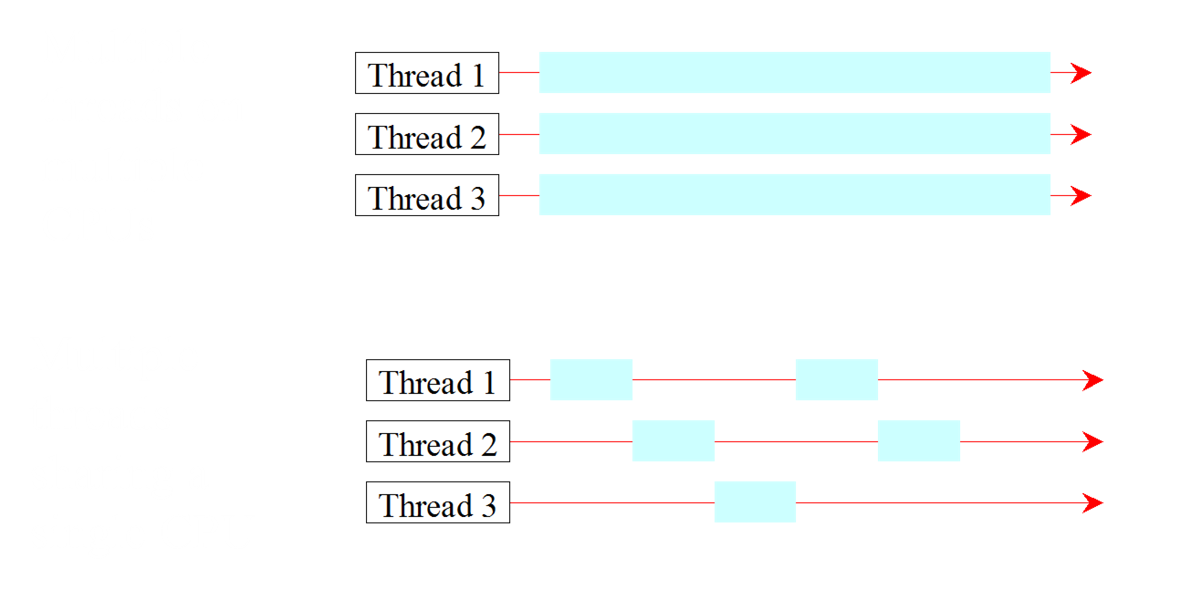
Threads Concept
Multiple threads on multiple CPUs
Multiple threads sharing a single CPU

Slide 25
Life cycle of a thread
A thread can be in one of these states once it is created: ready, running, blocked, finish
A ready thread is runnable, but not running, it needs allocation of CPU time.
Common ways for a running thread to become blocked include: waiting for I/O, sleep
A common way for a thread to finish is when it completes its execution of the run() method

Slide 26
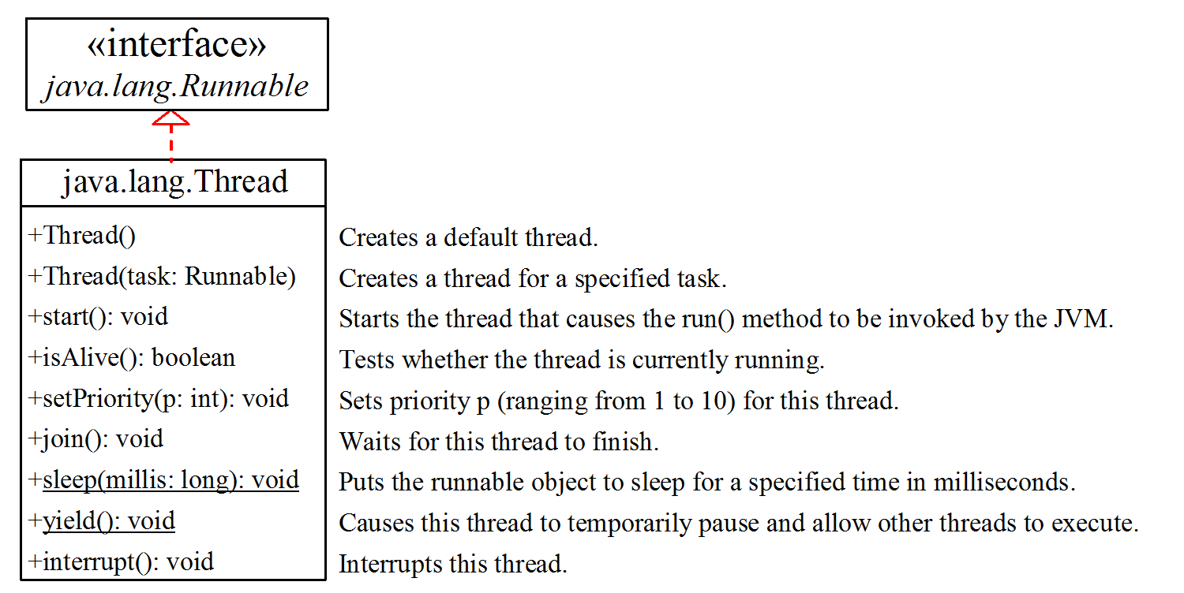
The Thread Class

Slide 27
The Static sleep(milliseconds) Method
The sleep(long mills) method puts the thread to sleep for the specified time in milliseconds. For example,
public void run() {
for (int i = 1; i <= lastNum; i++) {
System.out.print(" " + i);
try {
if (i >= 50) Thread.sleep(100);
}
catch (InterruptedException ex) {
…
}
}
}
Every time a number (>= 50) is printed, the thread is put to sleep for 1 millisecond.

Slide 28
The join() Method
You can use the join() method to force one thread to wait for another thread to finish.
The join method allows one thread to wait for the completion of another. If t is a Thread object whose thread is currently executing,
t.join();
causes the current thread to pause execution until t's thread terminates.
Overloads of join allow the programmer to specify a waiting period. However, as with sleep, join is dependent on the OS for timing, so you should not assume that join will wait exactly as long as you specify.
Notes:
Example, a group project. The overall coordinator fires off 3 or 4 worker threads. The coordinator will do some of its own work, and then it waits for all the worker threads to finish (or until a certain time has passed.)

Slide 29
Example - Printings
public class Printings implements Runnable {
public static final int
lastPrintNum = 20;
private final String id;
Printings(String id){
this.id=id;
}
@Override
public void run() {
try {
for (int i = 0; i < lastPrintNum; i++) {
System.out.println("Thread " + id + ":"+ i);
Thread.sleep(200);
}
} catch (InterruptedException ex) {
System.out.println("Thread " + id +
" is interrupted");
System.out.println("Thread " + id +
"is coming out the printing loop");
}
}
}

Slide 30
MyThreadApp - without join()
public class MyThreadApp1a {
public static final int lastMainNum = 5;
public static void main(String[] args) throws InterruptedException {
Thread t1 = new Thread(new Printings("t1"));
t1.start();// t1 starts to print id followed by a number
Thread.sleep(500);
for (int i = 0; i < lastMainNum; i++) {
System.out.println("Main " + i);
}
System.out.println("Does the main method have the last say?");
}
}

Slide 31
Output
without join()
Thread t1:0
Thread t1:1
Thread t1:2
Main 0
Main 1
Main 2
Main 3
Main 4
Does the main method have the last say?
Thread t1:3
Thread t1:4
…
Thread t1:18
Thread t1:19

Slide 32
MyThreadApp - with join()
public class MyThreadApp1a {
public static final int lastMainNum = 5;
public static void main(String[] args) throws InterruptedException {
Thread t1 = new Thread(new Printings("t1"));
t1.start();// t1 starts to print id followed by a number
Thread.sleep(500);
for (int i = 0; i < lastMainNum; i++) {
System.out.println("Main " + i);
}
t1.join();// the main thread will now wait until t1 finishes
System.out.println("Does the main method have the last say?");
}
}

Slide 33
Compare outputs
without join()
Thread t1:0
Thread t1:1
Thread t1:2
Main 0
Main 1
Main 2
Main 3
Main 4
Does the main method have the last say?
Thread t1:3
Thread t1:4
…
Thread t1:18
Thread t1:19
with join()
Thread t1:0
Thread t1:1
Thread t1:2
Main 0
Main 1
Main 2
Main 3
Main 4
Thread t1:3
Thread t1:4
…
Thread t1:18
Thread t1:19
Does the main method have the last say?

Slide 34
MyThreadApp - with join(xxx)
public class MyThreadApp1a {
public static final int lastMainNum = 5;
public static void main(String[] args) throws InterruptedException {
Thread t1 = new Thread(new Printings("t1"));
t1.start();// t1 starts to print id followed by a number
Thread.sleep(500);
for (int i = 0; i < lastMainNum; i++) {
System.out.println("Main " + i);
}
t1.join(1000);// the main thread will now wait for 1000 ms
System.out.println("Does the main method have the last say?");
}
}

Slide 35
Compare outputs
without join()
Thread t1:0
Thread t1:1
Thread t1:2
Main 0
Main 1
Main 2
Main 3
Main 4
Does the main method have the last say?
Thread t1:3
Thread t1:4
…
Thread t1:18
Thread t1:19
with join()
Thread t1:0
Thread t1:1
Thread t1:2
Main 0
Main 1
Main 2
Main 3
Main 4
Thread t1:3
Thread t1:4
…
Thread t1:18
Thread t1:19
Does the main method have the last say?
with join(1000)
Thread t1:0
Main 0
Main 1
Main 2
Main 3
Main 4
Thread t1:1
Thread t1:2
Thread t1:3
Thread t1:4
Thread t1:5
Does the main method have the last say?
Thread t1:6
…
Thread t1:18
Thread t1:19

Slide 36
isAlive(), interrupt(), and isInterrupted()
The isAlive() method is used to find out the state of a thread. It returns true if a thread is in the Ready, Blocked, or Running state; it returns false if a thread is new and has not started or if it is finished.
The interrupt() method interrupts a thread in the following way: If a thread is currently in the Ready or Running state, its interrupted flag is set; if a thread is currently blocked, it is awakened and enters the Ready state, and an InterruptedException is thrown.
The isInterrupt() method tests whether the thread is interrupted.

Slide 37
isAlive() and interrupt()
public class MyThreadApp1c {
public static final int lastMainNum = 5;
public static void main(String[] args) throws InterruptedException {
Thread t1 = new Thread(new Printings("t1"));
t1.start();// t1 starts to print id folowed by a number
Thread.sleep(500);
for (int i = 0; i < lastMainNum; i++) {
System.out.println("Main: " + i);
}
t1.join(1000);
System.out.println("Main: checking if t1 is still alive");
if (t1.isAlive()) {
System.out.println("Main: is t1 still going? I am going to interrupt t1");
t1.interrupt();
}
System.out.println("Main: Does the main method have the last say?");
}
}

Slide 38
Output – checking isAlive and interrupt
Thread t1:0
Thread t1:1
Thread t1:2
Main: 0
Main: 1
Main: 2
Main: 3
Main: 4
Thread t1:3
Thread t1:4
Thread t1:5
Thread t1:6
Thread t1:7
Main: checking if t1 is still alive
Main: is t1 still going? I am going to interrupt t1
Thread t1 is interrupted
Thread t1is coming out the printing loop
Main: Does the main method have the last say?

Slide 39
Examples for the practical sessions
In the next few slides, there are some examples about join(), isAlive() and interrrupt(). In your practical sessions, implement these and exam the output to make sure how the join() method works.

Slide 40
join() example - Printings
public class Printings implements Runnable {
public void run() {
try {
for (int i = 0; i < 20; i++) {
System.out.println("Thread : " + i);
Thread.sleep(200);
}
} catch (InterruptedException ex) {
System.out.println("Thread " + name + " is interrupted");
System.out.println("Thread " + name +"is coming out the printing loop");
}
}
}

Slide 41
join() example – MyThreadApp (Code fragments)
public static void main(String[] args) {
Thread t1 = new Thread(new Printings());
t1.start();// t1 starts to print id followed by a number
for (int i = 0; i <5; i++) {
System.out.println("Main :" + i);
System.out.println("wait for 500 ms");
t1.join(500);
}
//…. code including dealing with exception
System.out.println(“Do I have the last say?");
}

Slide 42
join() example results
Without the final join()
Main :0
wait for 500 ms
Thread :0
Thread :1
Thread :2
Main :1
…
Main :4
wait for 500 ms
Thread :11
Thread :12
Do I have the last say?
Thread :13
Thread :14
…
Thread :19
With the final join()
Main :0
wait for 500 ms
Thread :0
Thread :1
Thread :2
Main :1
…
Main :4
wait for 500 ms
Thread :11
Thread :12
Thread :13
Thread :14
…
Thread :19
Do I have the last say?
With interrupt
Main :0
wait for 500 ms
Thread :0
Thread :1
Thread :2
Main :1
…
Main :4
wait for 500 ms
Thread :10
Thread :11
Thread :12
Thread : is interrupted
Thread :is coming out the printing loop
Do I have the last say?

Slide 43
join() example – MyThreadApp 1 (Code fragments)
public static void main(String[] args) {
Thread t1 = new Thread(new Printings());
t1.start();// t1 starts to print id followed by a number
for (int i = 0; i <5; i++) {
System.out.println("Main " + i);
System.out.println("wait for 500 ms");
t1.join(500);
}
t1.join();
//…. code including dealing with exception
System.out.println(“Do I have the last say?”);
}

Slide 44
join() example results
Without the final join()
Main :0
wait for 500 ms
Thread :0
Thread :1
Thread :2
Main :1
…
Main :4
wait for 500 ms
Thread :11
Thread :12
Do I have the last say?
Thread :13
Thread :14
…
Thread :19
With the final join()
Main :0
wait for 500 ms
Thread :0
Thread :1
Thread :2
Main :1
…
Main :4
wait for 500 ms
Thread :11
Thread :12
Thread :13
Thread :14
…
Thread :19
Do I have the last say?
With interrupt
Main :0
wait for 500 ms
Thread :0
Thread :1
Thread :2
Main :1
…
Main :4
wait for 500 ms
Thread :10
Thread :11
Thread :12
Thread : is interrupted
Thread :is coming out the printing loop
Do I have the last say?

Slide 45
join() example – MyThreadApp 2 (Code fragments)
public static void main(String[] args) {
Thread t1 = new Thread(new Printings());
t1.start();// t1 starts to print id followed by a number
for (int i = 0; i <5; i++) {
System.out.println("Main " + i);
System.out.println("wait for 500 ms");
t1.join(500);
}
if (t1.isAlive()) {
t1.interrupt();
}
t1.join();
//…. code including dealing with exception
System.out.println(" Do I have the last say ");
}

Slide 46
join() example - Printings
public class Printings implements Runnable {
public void run() {
try {
for (int i = 0; i < 20; i++) {
System.out.println("Thread " + i);
Thread.sleep(200);
}
} catch (InterruptedException ex) {
System.out.println("Thread " + name + " is interrupted");
System.out.println("Thread " + name +"is coming out the printing loop");
}
}
}

Slide 47
join() example results
Without the final join()
Main :0
wait for 500 ms
Thread :0
Thread :1
Thread :2
Main :1
…
Main :4
wait for 500 ms
Thread :11
Thread :12
Do I have the last say?
Thread :13
Thread :14
…
Thread :19
With the final join()
Main :0
wait for 500 ms
Thread :0
Thread :1
Thread :2
Main :1
…
Main :4
wait for 500 ms
Thread :11
Thread :12
Thread :13
Thread :14
…
Thread :19
Do I have the last say?
With interrupt
Main :0
wait for 500 ms
Thread :0
Thread :1
Thread :2
Main :1
…
Main :4
wait for 500 ms
Thread :10
Thread :11
Thread :12
Thread : is interrupted
Thread :is coming out the printing loop
Do I have the last say?

Slide 48
Multithreading for user interface in GUI applications

Slide 49
Example: Flashing Rectangle
Press start, program displays a flashing rectangle until user presses the stop button.
One thread is tied to display the flashing rectangle.
In order to be able to accept user’s input, need more than one thread.

Slide 50
Implementations
Two classes: FlashControlPanel and FlashRec
FlashControlPanel deals with the graphical interface and the interaction with the user
Presents gui elements (behaves as a Frame)
Implements the actonPerformed method (behaves as an ActionListener)
To start a thread for displaying the “flashing”
To stop the thread
FlasRec deals with displaying the “flashing” effect.
A thread repeatedly sets the background colour to be red/green

Slide 51
Flash rectangle
class FlashRec extends JPanel implements Runnable{
private boolean keepgoing=false;
public void run() {
while (keepgoing) {
try {
setBackground(Color.red);
Thread.sleep(800);
setBackground(Color.green);
Thread.sleep(800);
} catch (Exception e) {…}
}//while
}//run
public void setKeepgoing(boolean b) {
keepgoing = b;
}
}

Slide 52
FlashControlPanel class 1
public class FlashControlPanel extends JFrame
implements ActionListener {
private JButton go = new JButton(“go");
private JButton stop=new JButton("stop");
private FlashRec fr;
private Thread recThread;
…
13/09/2016
Client-server Programming
52

Slide 53
FlashControlPanel class 2
FlashControlPanel() {
setSize(400,200);
fr=new FlashRec();
Container c = getContentPane();
c.add(go, "North");
go.addActionListener(this);
c.add(stop,"South");
stop.addActionListener(this);
c.add(fr, "Center");//
}//FlashControlPanel
13/09/2016
Client-server Programming
53

Slide 54
FlashControlPanel class 3
public void actionPerformed(ActionEvent e) {
if (e.getSource() == go ) {
recThread=new Thread(fr);
fr.setKeepgoing(true);
recThread.start();}
if (e.getSource() == stop) {
fr.setKeepgoing(false);
}//actionPerformed
}//end FlashControlPanel
The actual code is slightly more complex.

Slide 55
Demonstrate the bumble bee example
Notes for me
Bumble bee is in code\guisimulator
flashRec is in codezguisimulator
Lights is lecture\Cocurrency\guisimulator

Slide 56
BumbleTaskPanel
BumbleTaskPanel() {
img = ImageIO.read(new File("bumblebee.jpg"));
int imgSize = img.getHeight();
x = BumbleControl.X - imgSize;
y = BumbleControl.Y - imgSize;//initial bee position
}
public void paintComponent(Graphics g) {
super.paintComponent(g);
g.drawImage(img, x, y, null);
}

Slide 57
Run() method for Bumble Bee
public void run() {
while (keepgoing) {
if (x <= 0) x = BumbleControl.X;
if (y <= 0) y = BumbleControl.Y;
x -= 10;
y -= 10;
repaint();
Thread.sleep(100);
}//while
}//run

Slide 58
Review
Understand how to define and create threads in Java: extends Thread and implement Runnable
Be able to write simple Java thread applications
Notes:
Java's monitor supports two kinds of thread synchronization: mutual exclusion and cooperation. Mutual exclusion, which is supported in the Java virtual machine via object locks, enables multiple threads to independently work on shared data without interfering with each other. Cooperation, which is supported in the Java virtual machine via the wait and notify methods of class Object, enables threads to work together towards a common goal.
Thread acquires the intrinsic lock when it enters a synchronized method. Thread inside the synchronized method is set as the owner of the lock and is in RUNNABLE state. Any thread that attempts to enter the locked method becomes BLOCKED.
When thread calls wait it releases the current object lock (it keeps all locks from other objects) and than goes to WAITING state.
When some other thread calls notify or notifyAll on that same object the first thread changes state from WAITING to BLOCKED, Notified thread does NOT automatically reacquire the lock or become RUNNABLE, in fact it must fight for the lock with all other blocked threads.
WAITING and BLOCKED states both prevent thread from running, but they are very different.
WAITING threads must be explicitly transformed to BLOCKED threads by a notify from some other thread.
WAITING never goes directly to RUNNABLE.
When RUNNABLE thread releases the lock (by leaving monitor or by waiting) one of BLOCKED threads automatically takes its place.
So to summarize, thread acquires the lock when it enters synchronized method or when it reenters the synchronized method after the wait.
public synchronized guardedJoy() { // must get lock before entering here while(!joy) { try { wait(); // releases lock here // must regain the lock to reentering here } catch (InterruptedException e) {} } System.out.println("Joy and efficiency have been achieved!"); }

